Slide 1
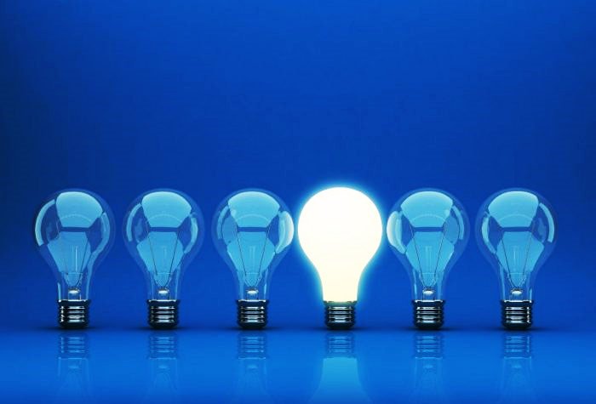
TRIVIA NIGHT
Get your answer sheet from the host to join in.

Slide 2
Round 1.
1) In Billy Joel's song "Piano Man", who or what is the old man making love to?
2) What word starting with V can mean 'word for word'?

Slide 3
Round 1.
3) What 2001 thriller starred Halle Berry, John Travolta, and Hugh Jackman?
4) What is the culinary term for the foot of a pig?

Slide 4
Round 1.
5) Blue Moon & Hopelessly Devoted to You are songs from which film musical?
6) Rock Lobster & Love Shack are both hits by which band?

Slide 5
Round 1.
7) Which film director did Madonna marry in 2000?
8) What term is given to the result of 'length times width times height' of a rectangular prism?

Slide 6
Round 1.
9) Nicolas Cage starred opposite which former James Bond actor in the 1996 film The Rock?
10) The logo of Mack Trucks is what animal?

Slide 7
Round 1.
11) What is the name of the brewery Peter Griffin works at in the TV show Family Guy?
12) How many provinces and territories are there in Canada?

Slide 8
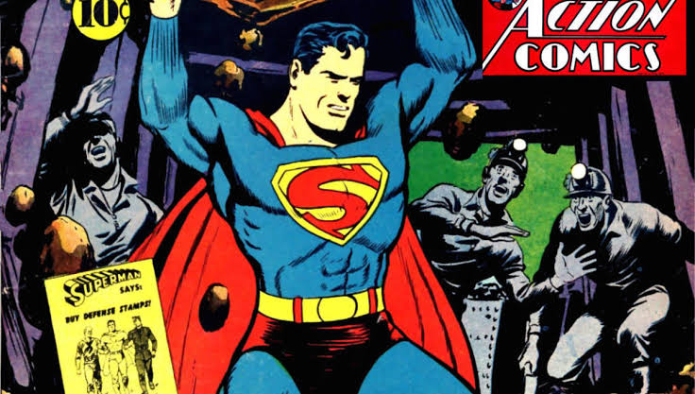
BONUS QUESTION.
Q) In what year did Superman first appear in a comic book?

Slide 9
Round 2.
1) The three holy cities of Islam, to which pilgrimage should be made are Medina, Jerusalem, and where?
2) In geometry, what is a polygon with seven sides and seven angles called?

Slide 10
Round 2.
3) Normandy is a part of which country?
4) What is inflammation of the gums called?

Slide 11
Round 2.
5) In what year did the following stories hit the news - Osama Bin Laden is killed, Prince William married Kate Middleton, Steve Jobs passed away?
6) What song by what band starts with the line "When I find myself in times of trouble, Mother Mary comes to me".?

Slide 12
Round 2.
7) Excluding dwarf planets, our solar system has a total of 8 planets. If you placed them in alphabetical order, what would be the last two planets?
8) What chocolate-covered wafer bar was originally launched in 1935 as “Rowntree's Chocolate Crisp”?

Slide 13
Round 2.
9) By definition, baby back ribs come from what animal?
10) Who received an Oscar nomination for her performance as Mexican painter Frida Kahlo in the 2002 biopic Frida?

Slide 14
Round 2.
11) Which retired U.S hall of fame tennis player who is known for his confrontational on-court behavior that often landed him in trouble with tennis authorities?
12) By what nickname was the late Koby Bryant often called?

Slide 15
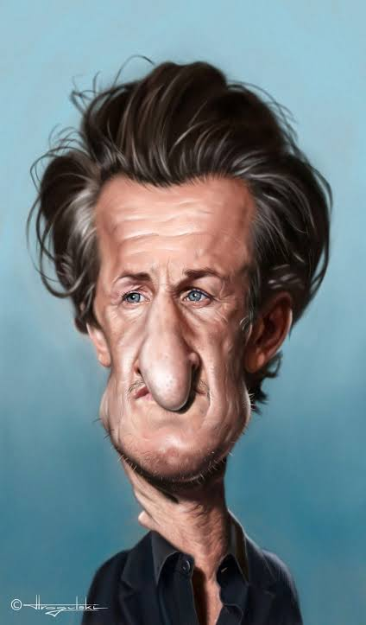
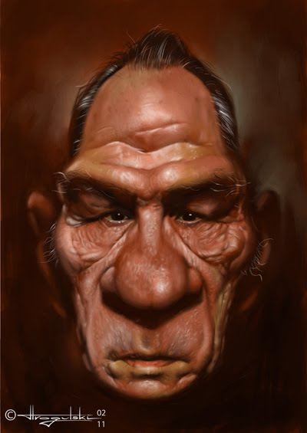
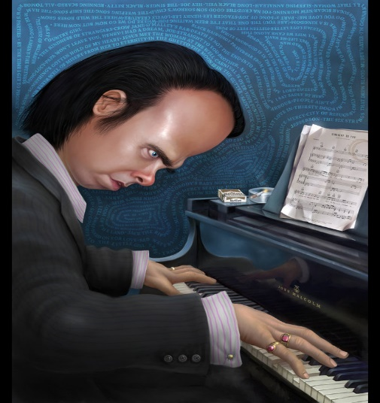
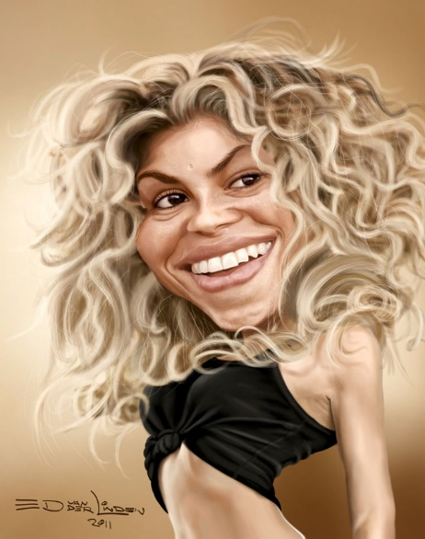
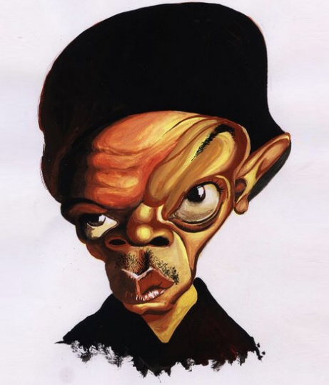
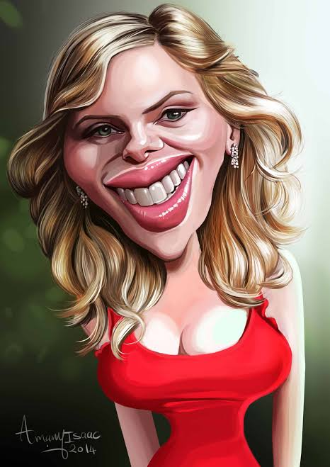
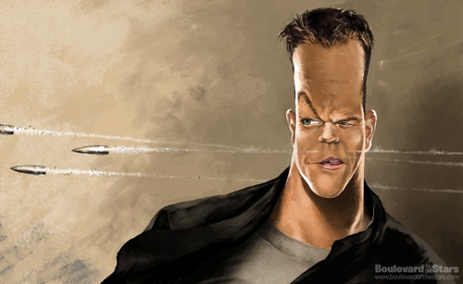
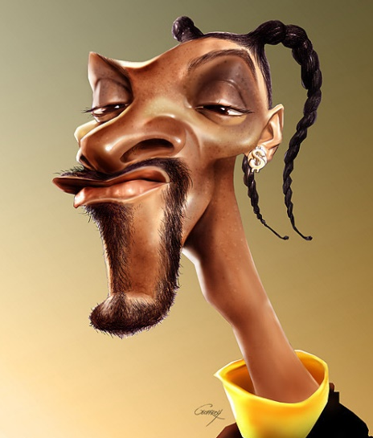
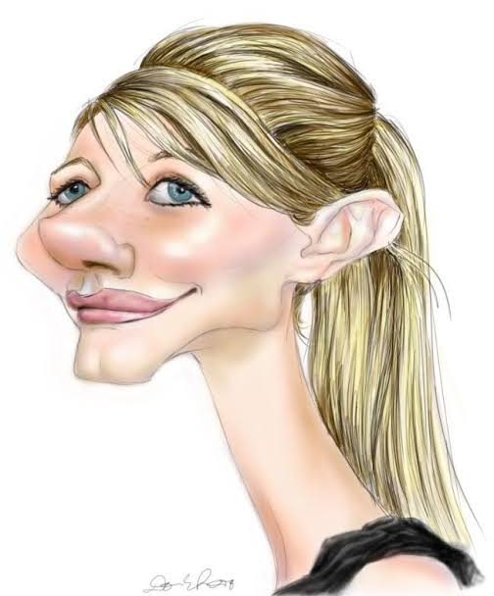
Celebrity Caricatures
1.__________
2.__________
3.__________
4.__________
5.__________
6.__________
7.__________
8.__________
9.__________
10._________

Slide 16
True or False.
1) China has only one time zone.
2) Augustus was the first emperor of the Roman Empire.

Slide 17
True or False.
3) The bone on your heal is the hardest part of a human body.
4) A coffee taster from London has had his tongue insured for £10 million.

Slide 18
True or False.
5) In World War II, Germany tried to collapse the British economy by dropping millions of counterfeit bills over London.
6) Deoxygenated blood is blue.

Slide 19
True or False.
7) The first male to survive a trip down Niagara falls in a barrel later died from injuries caused by slipping on an orange peel.
8) Only 4 percent of Americans surveyed consider themselves less intelligent than average.

Slide 20
True or False.
9) Lobsters have their teeth in their stomach.
10) Statistically speaking, you are more likely to die from a dog attack then a shark attack.

Slide 21
Round 3.
1) What modern country was called Hispania Lusitania by the Romans - Spain, Portugal, Italy or Israel?
2) What name is given to the passenger seat on a motorcycle?

Slide 22
Round 3.
3) Adventurer Marco Polo famously lived in which European city?
4) Edward Smith was the captain of which ship?

Slide 23
Round 3.
5) What is the largest river in the world by volume?
6) What three words are missing from the Cool Runnings line "Feel the Rhythm! Feel the Rhyme! ___ __ __, it's bobsled time! Cool Runnings!"?

Slide 24
Round 3.
7) What monetary unit is shared by Mexico, Argentina, Chile, & Colombia?
8) Which continent has the larger population; Europe, Africa or North America?

Slide 25
Round 3.
9) In the TV show "The Simpsons", what is the name of Homer's half brother?
10) What generation was born between the years 1977 & 1995?

Slide 26
Round 3.
11) A substance is said to be alkaline if it has a ph. value above what number?
12) Chinese New Year is upon us. What animal is this year's symbol of Chinese New Year?

Slide 27
Name the Songs & Artists
(Click picture to play)

Slide 28
Round 4.
1) Where in the human body is the amygdala?
2) What inner tube connects your middle ear to the upper throat and the back of the nasal cavity?

Slide 29
Round 4.
3) Machu Picchu is found in which South American country?
4) What does the H stand for in VHF?

Slide 30
Round 4.
5) What is the name of the man behind the character Borat?
6) Which word of French origin means 'a broad, well-paved thoroughfare'?

Slide 31
Round 4.
7) What is the name of the root spice often used to flavor sushi?
8) What are the names of the two bones that connect to your knee's? (one point each)

Slide 32
Round 4.
9) In which country will you find The Pyramid of the Sun and the Mayan remains?
10) What is the European Union's equivalent to the North American's "911" emergency number?

Slide 33
Round 4.
11) Which two solo artists performed together at this years Super Bowl LIV?
12) Which female artist won the most 2020 Grammy Awards ?

Slide 34
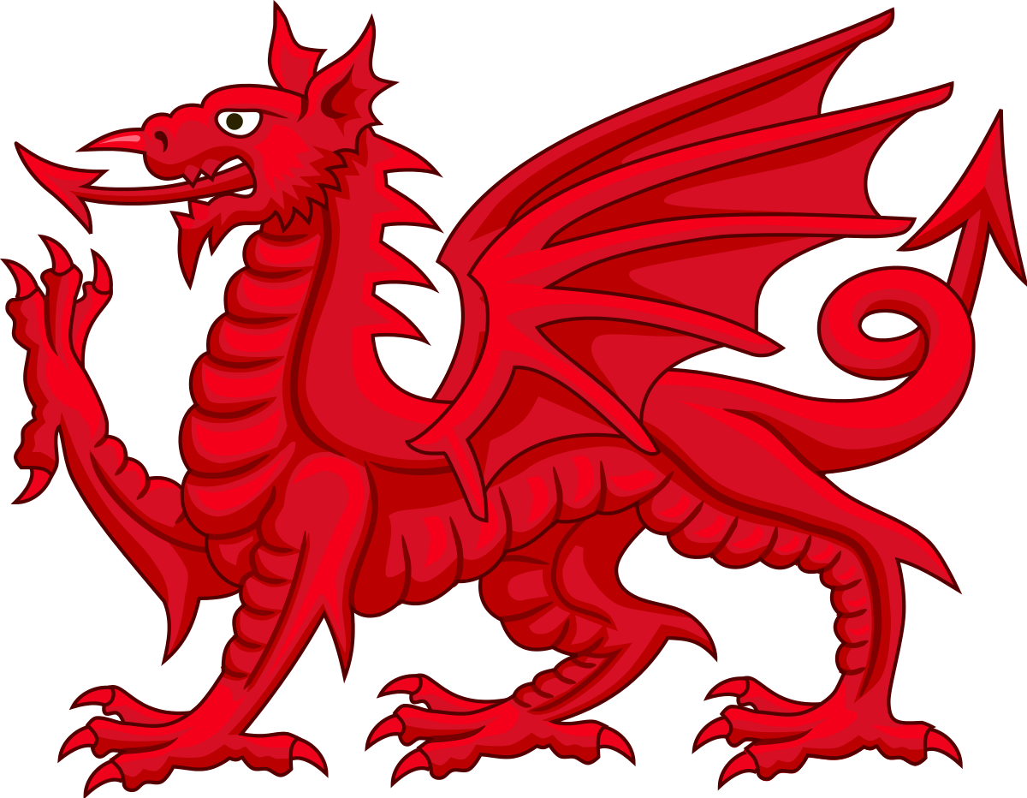
Jackpot Question!
Q) What vegetable is the national emblem of Wales?

Slide 35
TIE BREAKERs
1) In what year did Charles Darwin release the book the Origin of Species?
2) How many islands does Fiji have?
3) How many total episodes aired of the Fox sitcom Married… With Children?

Slide 36
Thanks for playing!
Book now for next week!

