Slide 1
TRIVIA NIGHT
Get your answer sheet from the host to join in.

Slide 2
Round 1.
1) Billie Joe Armstrong is the lead singer of which band?
2) What bodily organ stores bile after it is produced by the liver?

Slide 3
Round 1.
3) In the visible light spectrum what color appears between yellow and blue?
4) In what year was the first ever Woodstock festival held in Bethel, White Lake, New York?

Slide 4
Round 1.
5) What is the name of Fred and Wilma's daughter in The Flintstones?
6) You have probably sung this song every time you ordered a Pina Colada, "If you like Pina Coladas, and getting caught in the rain? But do you know who sings it?

Slide 5
Round 1.
7) Slalom, downhill, and cross-country are all competitive disciplines in which sport?
8) What is the name of the football stadium in Green Bay, Wisconsin, that is the home of the city's NFL team, the Packers?

Slide 6
Round 1.
9) What type of animal is a Booby?
10) The Seychelles is an archipelago of many islands located in which ocean?

Slide 7
Round 1.
11) Who was responsible for killing Harry Potters parents?
12) Who created the Mr Men and Little Miss series?

Slide 8
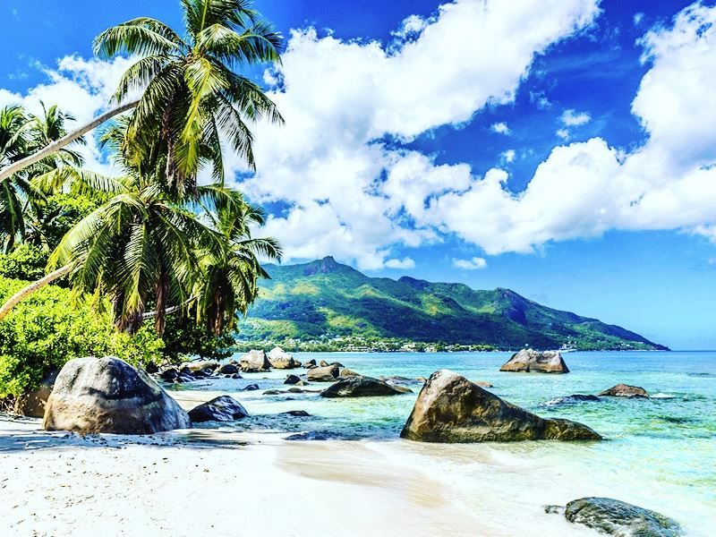
BONUS QUESTION.
Q) How many islands make up The Seychelles?

Slide 9
Round 2.
1) Who preceded Ronald Reagan as President of the USA?
2) Does acid reduce or add to the pH level of water?

Slide 10
Round 2.
3) Which city is the capital of Fiji?
4) How many muscles are there in your fingers?

Slide 11
Round 2.
5) Never Say Never is a 2011 American concert film centering on which pop singer?
6) Which unit of measurement is used to measure the height of a horse?

Slide 12
Round 2.
7) On 16 December 1971, East Pakistan was liberated from Pakistan and is now known internationally as what?
8) What piece of military weaponry gets its name from the Ancient Greek word for “To hurl”?

Slide 13
Round 2.
9) What is the name of the tiny, independent landlocked country situated between France and Spain in the Pyrenees mountains?
10) In what year was the original movie 'The Hunger Games' released?

Slide 14
Round 2.
11) What popular app’s mascot is named “Ghostface Chillah” in honor of Wu-Tang Clan rapper Ghostface Killah?
12) Which Asian country was formally known as Siam?

Slide 15
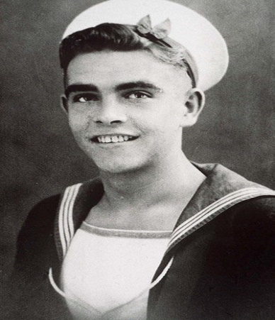
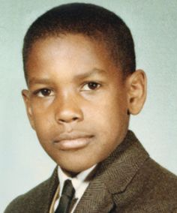
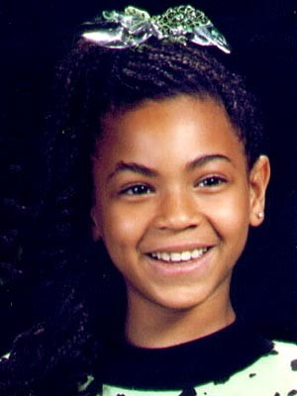
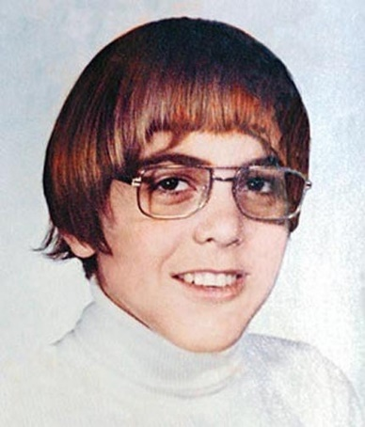
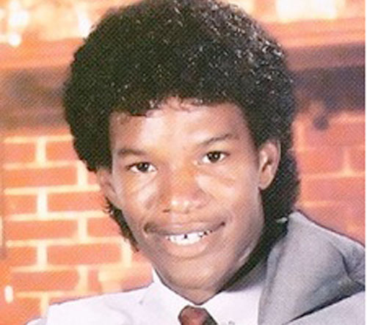
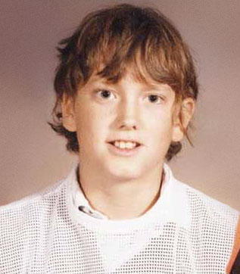
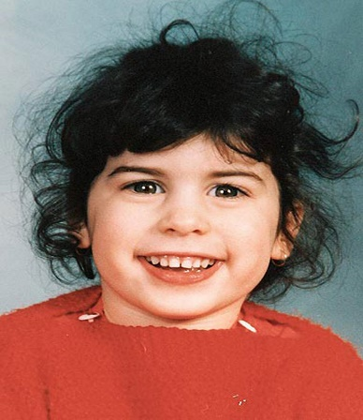
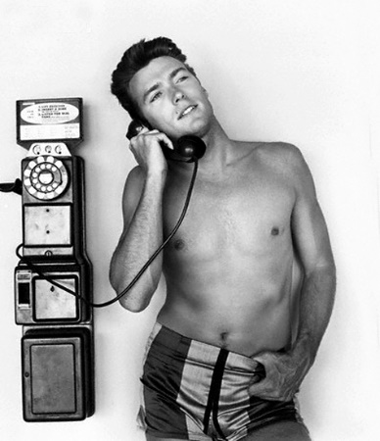
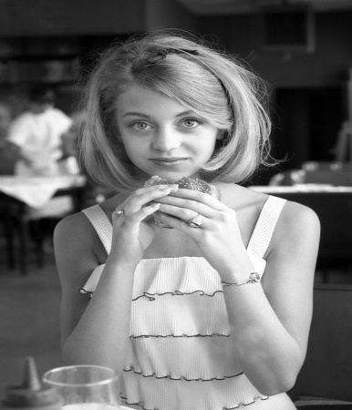
When they were young.
1.__________
2.__________
3.__________
4.__________
5.__________
6.__________
7.__________
8.__________
9.__________
10._________

Slide 16
Round 3.
1) What famous actor has played the superhero roles of both Storm & Catwoman?
2) What name is given to a currency that a government has declared to be legal tender, but it is not backed by a physical commodity?

Slide 17
Round 3.
3) Who was the founder of the Mongol Empire?
4) What is the largest continent on earth?

Slide 18
Round 3.
5) Monotremes are mammals that do what?
6) The French school and the Balanchine method are just two methods of instruction for what style of dance?

Slide 19
Round 3.
7) Ingvar Kamprad, the founder of which Swedish global company has died last week aged 91?
8) What’s the name of the island where the movie The Beach was filmed?

Slide 20
Round 3.
9) In what country did Roger Federer take his 20th Grand Slam win last week?
10) How many lakes make up the Great Lakes of North America?

Slide 21
Round 3.
11) True or false: UK Prime Minister Theresa May has appointed a minister for loneliness?
12) Roger Federer won his 20th grand slam title by defeating who in a five-set thriller in the Australian Open?

Slide 22
Name the Songs & Artists.
(Click picture to play)

Slide 23
Round 4.
1) Amy Wong and Professor Farnsworth are characters in which animated TV series?
2) What major company owns the Dasani brand of bottled water?

Slide 24
Round 4.
3) The Cheshire Cat is a fictional cat popularised by which movie?
4) The Kelvin is the primary unit used to measure what in the physical sciences?

Slide 25
Round 4.
5) Who sang the original song, When Dive’s Cry?
6) Metro-Goldwyn-Mayer Studios uses what animal in its logo?

Slide 26
Round 4.
7) What is a female donkey called?
8) How many bits are there in a byte?

Slide 27
Round 4.
9) In the TV series "Sex And The City", which of the girls is first to get married?
10) Which band recorded the 1978 song, Roxanne?

Slide 28
Round 4.
11) What was the name of the prehistoric supercontinent that existed during the late Paleozoic and early Mesozoic eras?
12) Which famous rapper has recently announced he forgot that he had about $9.9 million worth of bitcoin?

Slide 29
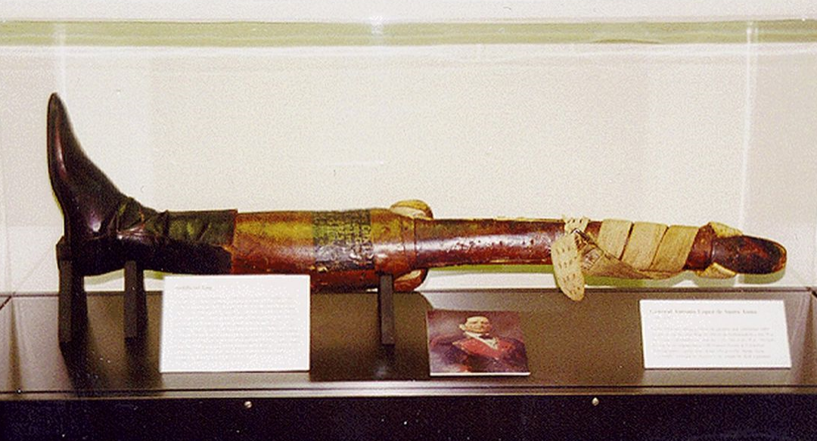
Jackpot Question!
Q) What is the name of the Mexican General who held a state funeral for his amputated leg?

Slide 30
TIE BREAKERs
1) Who said, 'Let us be thankful for the fools. But for them, the rest of us could not succeed'?
2) What are female ferrets called?
3) What year was The Offspring song - Pretty Fly (For a White Guy) released?

Slide 31
Thanks for playing!
Book now for next week!

